Slide 1
Financial Fresh Start
National Association of Women Judges, Success Inside & Out
Presentation Given at Las Colinas Detention and Reentry Facility
September 29, 2023

Slide 2
STARTING FRESH AFTER YOUR RELEASE and MEETING YOUR NEEDS

Slide 3
What are your needs?
Freedom to Thrive:
Love & Belonging
Freedom from Fear:
Feeling Safe & Secure
Freedom from Want:
Survival
Freedom to Grow: Self-Improvement & Achievement
Freedom to Progress: Higher Purpose
Self-fulfillment
Self-esteem, Education
Family, Acceptance, Understanding
Physical & Emotional Safety
Shelter, Food, Clothing
Notes:
Resources are vast and will offer you multiple opportunities. An important question is what your needs are. It is important to address your basic needs first and then proceed with more complex wishes and wants.

Slide 4
Freedom from Want
Freedom to Thrive:
Love & Belonging
Freedom from Fear:
Feeling Safe & Secure
Freedom from Want:
Survival
Freedom to Grow: Self-Improvement & Achievement
Freedom to Progress: Higher Purpose
You want to start over. You need somewhere to live, to work. You need counseling, but have limited resources. The first step is to get on your feet and survive.

Slide 5
Freedom from Want: Financial Subsidies and Assistance
Freedom to Thrive:
Love & Belonging
Freedom from Fear:
Feeling Safe & Secure
Freedom from Want:
Survival
Freedom to Grow: Self-Improvement & Achievement
Freedom to Progress: Higher Purpose
Temporary Assistance for Needy Families (TANF) provides temporary assistance to help pay for food, shelter, utilities, and non-medical expenses for qualifying families: https://www.acf.hhs.gov/ofa/programs/tanf
Second Chance is a San Diego local non-profit organization that provides assistance to people with addiction, incarceration, homelessness, a family history of criminal behavior or gang involvement: https://www.secondchanceprogram.org/
In addition to the Job Readiness Training program, Second Chance has support services (CDL, Birth certificates, work clothes, tools, transportation and much more) money available to help the participants on their journey to self-sufficiency) and hygiene kits.
California Work Opportunity and Responsibility to Kids (CalWORKs) is a public assistance program that provides cash aid and services to eligible families that have a child(ren) in the home. If a family has little or no cash and needs housing, food, utilities, clothing or medical care, they may be eligible to receive immediate short-term help. Families that apply and qualify for ongoing assistance receive money each month to help pay for housing, food and other necessary expenses: http://www.cdss.ca.gov/CalWORKS

Slide 6
Freedom from Want: Financial Subsidies and Assistance
Freedom to Thrive:
Love & Belonging
Freedom from Fear:
Feeling Safe & Secure
Freedom from Want:
Survival
Freedom to Grow: Self-Improvement & Achievement
Freedom to Progress: Higher Purpose
General Relief
Temporary cash assistance
Maximum monthly grant is $370
Eligibility:
Have been a San Diego County resident for at least 15 days
Intend to reside in San Diego County
Valid ID
Income less than $337 (for a single person) or $460 (for a married couple)
Very limited resources (a vehicle of up to $4,650 in value is exempt)
“Repaid to County” requirements
Apply in person at County offices listed below or online at Benefits Cal:
https://www.sandiegocounty.gov/content/sdc/hhsa/programs/ssp/general_relief/how_to_apply.html
https://benefitscal.com/

Slide 7
Facilities where this Service is offered:
Family Resource Center - El Cajon
Family Resource Center - Metro
Family Resource Center - North Coastal
Family Resource Center - North Inland
Family Resource Center - Chula Vista
Family Resource Center - Centre City
For more information call 1-866-262-9881.

Slide 8
Freedom from Want: Food Subsidies
Freedom to Thrive:
Love & Belonging
Freedom from Fear:
Feeling Safe & Secure
Freedom from Want:
Survival
Freedom to Grow: Self-Improvement & Achievement
Freedom to Progress: Higher Purpose
Supplemental Nutrition Assistance Program (SNAP/CalFresh) (aka « food stamps ») offers nutrition assistance to millions of eligible, low-income individuals and families and provides economic benefits to communities: https://www.sandiegocounty.gov/content/sdc/hhsa/ programs/ssp/food_stamps.html. This program is accessed by using an Electronic Benefit Transfer (EBT) card. Effective Summer 2019, SSI recipients are no longer banned from receiving SNAP/CalFresh.
The Emergency Food Assistance Program (TEFAP) is a Federal program that helps supplement the diets of low-income Americans, including elderly people, by providing them with emergency food and nutrition assistance at no cost: https://www.fns.usda.gov/tefap/emergency-food-assistance-program-tefap
The Special Supplemental Nutrition Program for Women, Infants, and Children (WIC) provides Federal grants to States for supplemental foods, health care referrals, and nutrition education for low-income pregnant, breastfeeding, and non-breastfeeding postpartum women, and to infants and children up to age five who are found to be at nutritional risk: https://www.fns.usda.gov/wic/women-infants-and-children-wic
San Diego Food Bank is the largest hunger-relief organization in San Diego County providing nutritious food to individuals and families in need in communities throughout the area: https://sandiegofoodbank.org/

Slide 9
Freedom from Want: Housing
Freedom to Thrive:
Love & Belonging
Freedom from Fear:
Feeling Safe & Secure
Freedom from Want:
Survival
Freedom to Grow: Self-Improvement & Achievement
Freedom to Progress: Higher Purpose
211 San Diego – Reentry Services provides a resource guide with a list of housing options available for individuals released from a local jail or state prison: http://211sandiego.org/resources/highlighted-resources/post-incarceration/
Sober Living Housing
For those with MSO (Most Serious Offense), probation will most likely pay for three months of sober living and help with a bus pass when they can.
Second Chance Housing program provides quality and supportive sober living housing: https://www.secondchanceprogram.org/housing/
Ex-Offender Halfway Houses: http://sandiego.networkofcare.org/mh/services/subcategory.aspx?tax=FF-1850
Transitional Housing Program (THP) is a voluntary program that provides residency and support services to parolees to enable successful reintegration into their communities. The program offers services that focus on Long Term Offenders (LTOs) needs such as employment, job search and placement training, stress management, victim awareness, computer supported literacy, and life skills. Substance Abuse education and a 52-week certified domestic violence program is provided to applicable parolees. Visit https://www.cdcr.ca.gov/rehabilitation/thp/
East County Transitional Living Center may be an option: https://www.ectlc.org/

Slide 10
Freedom from Want: Housing Assistance Programs
Freedom to Thrive:
Love & Belonging
Freedom from Fear:
Feeling Safe & Secure
Freedom from Want:
Survival
Freedom to Grow: Self-Improvement & Achievement
Freedom to Progress: Higher Purpose
Types of Housing Assistance
Housing Choice Voucher Program – contribute % of income as rent
Low Income Housing Tax Credit properties – pay a set amount in rent
Other types, including for elderly, persons with HIV/AIDS, etc.
When Applying for Housing Assistance:
Important to maintain position on waitlists (change of address, etc.)
Eligibility requirements exist, but must be in writing and available (request a copy)
Criminal history rules apply, keep in mind:
Length of time since conviction may be considered
Certain convictions serve as a bar
If denied because of criminal conviction, seek legal assistance to see if there is basis to appeal (mistakes happen and records may not be accurate)
Apply online or in person at Public Housing Authorities
San Diego Housing Commission (SDHC)
Housing Authority of the County of San Diego (HACSD)
Other cities in region also have housing authorities

Slide 11
Freedom from Want: Employment
Freedom to Thrive:
Love & Belonging
Freedom from Fear:
Feeling Safe & Secure
Freedom from Want:
Survival
Freedom to Grow: Self-Improvement & Achievement
Freedom to Progress: Higher Purpose
The Department of Labor: Employment and Training Administration has several grant programs for felons that are pre-release as well as for ex-felons that are out of prison. Most grants are also open to anyone who applies whether they are a felon or not. Visit https://www.grants.gov/web/grants/home.html to apply.
As a part of the effort to reduce recidivism and break the cycle of crime to make American communities safer, the U.S. Department of Labor recently announced an $82.5 million investment to help Americans exit incarceration and integrate into the workforce. . The investment will support programs that offer a range of services based on current evidence and proven research, as well as promising emerging practices.
Career OneStop is a source for employment information and inspiration, the place to manage your career, the pathway to career success, tools to help job seekers. It has a specific section for ex-offenders that provides state resources and helpful information about hiring and approaches to job seeking with a conviction on the record. Visit https://www.careeronestop.org/ExOffender/default.aspx.
SDWP Job Centers offer comprehensive job search services and access to: workshops, hiring events, training programs and other resources: https://workforce.org/careercenters
Notes:
CareerOneStop
CareerOneStop
CareerOneStop is sponsored by the U.S. Department of Labor.

Slide 12
Freedom from Want: While you are Searching for a Job
Freedom to Thrive:
Love & Belonging
Freedom from Fear:
Feeling Safe & Secure
Freedom from Want:
Survival
Freedom to Grow: Self-Improvement & Achievement
Freedom to Progress: Higher Purpose
Second Chance offers a Job Readiness Program https://www.secondchanceprogram.org
You would be ineligible for unemployment benefits when coming out of custody.
In San Diego County, you can apply for General Relief: https://www.sandiegocounty.gov/content/sdc/hhsa/programs/ssp/general_relief.html
General Relief provides temporary cash assistance for eligible county residents who have no other means of support. Any aid received must be repaid to the county. Completed hours of required Job Training may count toward repayment of the debt.

Slide 13
Freedom from Want: Healthcare
Freedom to Thrive:
Love & Belonging
Freedom from Fear:
Feeling Safe & Secure
Freedom from Want:
Survival
Freedom to Grow: Self-Improvement & Achievement
Freedom to Progress: Higher Purpose
General information about benefits for all states is found at https://www.hhs.gov/answers/medicare-and-medicaid/who-is-eligible-for-medicaid/index.html
After you’re released, you must either have health coverage, pay the fee, or get an exemption.
After you’re released, you have a 60-day Special Enrollment Period to sign up for private health coverage. During this time, you can enroll in private health insurance even if it’s outside the Marketplace Open Enrollment Period.
After this 60-day Special Enrollment Period, you can’t buy private health insurance until the next Marketplace Open Enrollment Period (unless you qualify for another Special Enrollment Period). That may result in a fee.
Explore https://www.healthcare.gov/quick-guide/ for your private insurance options.
You may be eligible for Medicaid/Medi-Cal coverage:
You can apply for Medicaid/Medi-Cal coverage while incarcerated. Enrolling in Medicaid while incarcerated doesn’t allow Medicaid to pay the cost of your care while in prison or jail. But it may help you get needed care more quickly after you’re released.

Slide 14
Freedom from Want: Release of your Driver’s License
Freedom to Thrive:
Love & Belonging
Freedom from Fear:
Feeling Safe & Secure
Freedom from Want:
Survival
Freedom to Grow: Self-Improvement & Achievement
Freedom to Progress: Higher Purpose
Visit www.dmv.ca.gov
If the suspension involves a criminal offense (i.e. DUI) seek assistance from a criminal attorney. Find a free legal aid society or get a referral from a local bar association.
For non-child support related holds or suspensions seek a DMV Abstract through the traffic court.
To obtain a release of a driver’s license for failure to pay child support: San Diego Superior Court Facilitator’s Office will assist in filling out an ex parte application for a release of a driver’s license. The Facilitators work for free assisting parties to fill out forms (Judicial Council Form FL-670 ). Go to www.sdcourt.ca.gov, under “Divisions”, “Family” then “self-help services”. The facilitator’s office has both walk in and appointment times. The ex parte application is a simple one-page form. You may also contact your DCSS case manager and they will sometimes agree to a release of the driver’s license upon signing a payment program agreement. If that option is not successful you may always pursue the ex parte application before the court.

Slide 15
Freedom from Fear: Support and Guidance
Freedom to Thrive:
Love & Belonging
Freedom from Fear:
Feeling Safe & Secure
Freedom from Want:
Survival
Freedom to Grow: Self-Improvement & Achievement
Freedom to Progress: Higher Purpose
San Diego Family Justice Center is a public safety initiative launched by the City of San Diego to assist victims of family violence. It was the first comprehensive "one-stop shop" in the nation for victims of family violence and their children. Under one roof, more than twenty-five agencies have come together to provide consolidated and coordinated legal, social, and health services to women, men, children, and families in need. Victims of family violence can now come to one location to talk to an advocate, get a retraining order, plan for their safety, talk to a police officer, meet with a prosecutor, and receive information on shelter.
https://www.sandiego.gov/sandiegofamilyjusticecenter/fjcinfo

Slide 16
Freedom to Grow: Education
Freedom to Thrive:
Love & Belonging
Freedom from Fear:
Feeling Safe & Secure
Freedom from Want:
Survival
Freedom to Grow: Self-Improvement & Achievement
Freedom to Progress: Higher Purpose
Obtain your GED information
Bureau of Prisons can assist with the search on how to obtain the information depending on the facility where you are released from: https://www.bop.gov/resources/GED_info.jsp
You may apply for financial aid while you are incarcerated.
There are cases when you’re ineligible:
If you are incarcerated in a jail facility you may not receive financial aid. This does not apply to halfway houses, home detention, or if you only serve on weekends.
If you are convicted of a drug-related offence:
Possession convictions: First offenders are ineligible for one year from the date of the conviction, second offense-2 years, third offense-indefinitely.
Sale convictions: First offense-2 years, second offense-indefinitely.
Those suspended can resume eligibility if they participate in a qualified drug rehabilitation program while passing two unannounced drug tests.
You may receive financial aid while on parole or probation.

Slide 17
Legal Assistance to Meet Your Needs
Court-Based Programs: http://www.courts.ca.gov/selfhelp-lowcosthelp.htm
Family Law Facilitator (FLF) works for the court and is a lawyer who can help parents or children who do not have their own lawyer. The FLF is free.
Small Claims Advisor (SCA) give free legal information in small claims cases. The kinds of services offered vary from county to county. The court clerk's office can tell you about the services available in your court.
Self-Help Center (SHC) is available in all California courts and provides free legal help to people who do not have a lawyer. How much help you can get, and with what types of legal problems, varies from court to court.
Law Schools have free legal clinics for certain types of legal problems. E.g., USD School of Law's free legal clinics offer assistance to underserved members: https://www.sandiego.edu/law/donor-relations/how-to-support/legal-clinics.php
Legal Aid Society of San Diego. https://www.lassd.org/

Slide 18
Freedom from Indebtedness
Freedom to Thrive:
Love & Belonging
Freedom from Fear:
Feeling Safe & Secure
Freedom from Want:
Survival
Freedom to Grow: Self-Improvement & Achievement
Freedom to Progress: Higher Purpose
STEP 1: Pay Off or Eliminate Current Debt.
Bankruptcy
Debt Management Program
Debt Settlement
Seek legal help to assess your options.
STEP 2: Start Rebuilding Your Credit.
STEP 3: Create a Realistic Budget and Stick to It.
Notes:
There is one more freedom that YOU need to seek. This is freedom from indebtedness.

Slide 19
BANKRUPTCY

Slide 20
Before filing for Bankruptcy, consider:
There are two main types of personal bankruptcy. Chapter 7 allows you to walk away from most debts entirely as explained later. Chapter 13 allows you to repay all or part of the debts over three to five years.
Do not use bankruptcy frivolously. The most common reasons for bankruptcy: divorce, unemployment and medical bills.
Filing bankruptcy doesn't mean giving up all your possessions. You keep your personal property, such as clothes, electronics, household furnishings and other exempt assets. You can sometimes retain larger assets, such as cars and the family home.
Bankruptcy is not cheap. Costs vary depending on your attorney and location. But in general, a Chapter 7 can run $1,500 to $2,500, while a Chapter 13 can run $2,000 to $4,000.
You may be able to get free or low-cost legal help.
Bankruptcy goes on your credit history and will stay on it about 10 years.
Bankruptcy is public.
While bankruptcy discharges SOME debts, it does not discharge ALL debts.

Slide 21
Bankruptcy Limitations
What It Can Do
Wipe out credit card debt and other unsecured debt
Stop creditor harassment and collection activities
And What It Does Not Do…
Prevent a secured creditor from repossessing property
Eliminate child support and alimony obligations
Eliminate certain kinds of liens
Wipe out student loans, except in very limited circumstances
Eliminate most tax debts
Remove fines and penalties imposed for violating the law, such as traffic tickets and criminal restitution
Eliminate debts for personal injury or death caused by your intoxicated driving
Such as if the creditor is about to repossess your car or foreclose your mortgage

Slide 22
How to Treat Fines and Penalties
Fines: You may set up a payment plan with the courts. The minimum payment is $35 per month. If your fines have been enhanced with a civil assessment for failure to pay, you may request the court to set aside the civil assessment for inability to pay. Also you may explore asking the court to convert some of the fines to volunteer work service if you cannot pay. You may add your case onto the calendar through the criminal business office of the Superior Court at the courthouse where the case was heard.
Restitution: Restitution is payment owed by a defendant directly to a victim of a crime. If you owe restitution, while the court cannot lower the amount owed to the victim – the court may lower or modify the monthly payments. You may go to the criminal business office of the Superior Court where the case was heard to add your matter on to the calendar to request lower payments.

Slide 23
Legal Assistance in Bankruptcy
Legal Aid Society of San Diego hosts a no-cost Bankruptcy Self-Help Center for Pro Se Filers at the U.S. Bankruptcy Court, 325 West F Street, San Diego every Wednesday from 2:00 to 4:00 pm.
No appointments are necessary.
The Self-Help Center is located on the 2nd floor of the Weinberger Courthouse in the Court Library.

Slide 24
CREDIT REPAIR

Slide 25
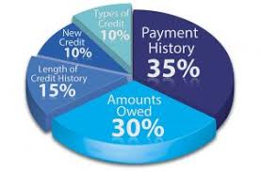
What Are Credit Reports?
Contain information about your credit and repayment history.
Credit cards, rent payments, utilities, judgments, bankruptcies, medical bills.
Credit reports exist only for people who have established a credit history.
Having no credit history can have adverse consequences.
Your credit score is generated from your credit report.
Your credit score elements:
Payment history: 35%
Amounts owed: 30%
Length of credit history: 15%
Types of credit used: 10%
New credit: 10%

Slide 26
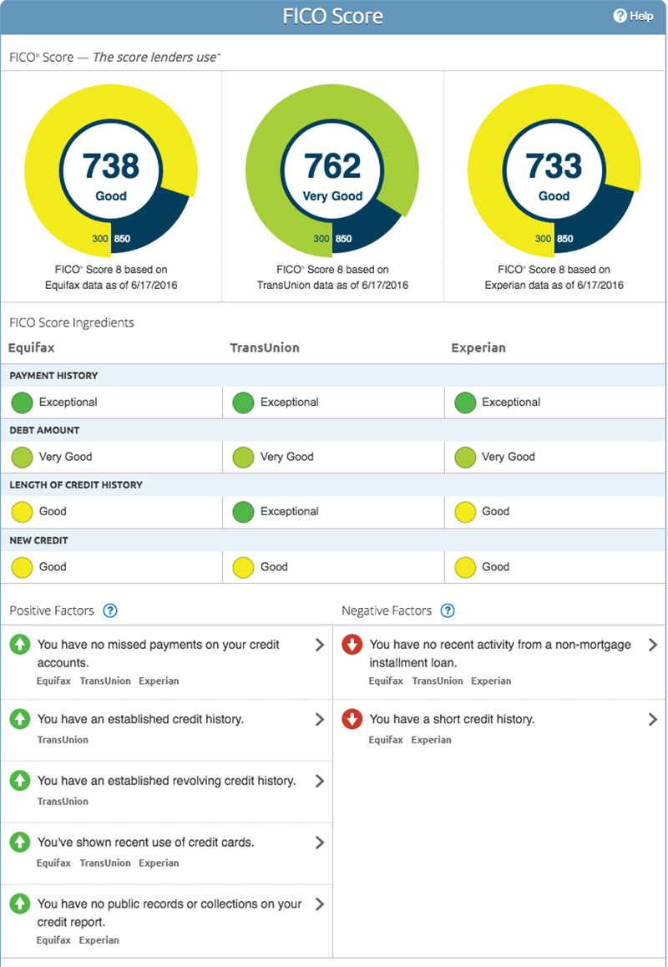
What Should You Do With Your Credit Report?
Get Your Credit Report Now! And Again Each Year!
It is free: order a copy from each of the major credit reporting agencies once every year: Experian, Equifax, and Transunion.
Do not go to www.FreeCreditReport.com – it is NOT free.

Slide 27
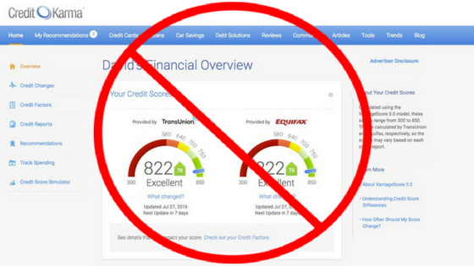
How Do You Get Your Credit Report?
All consumers are entitled to one free credit report from all three major credit reporting bureaus (Experian, Equifax, and TransUnion) to ensure credit reports are current and correct: www.annualcreditreport.com
Do NOT use companies that advertise on TV to check your credit (i.e. Credit Karma). Often these companies sell your information in order to provide you with a “free” credit report.

Slide 28
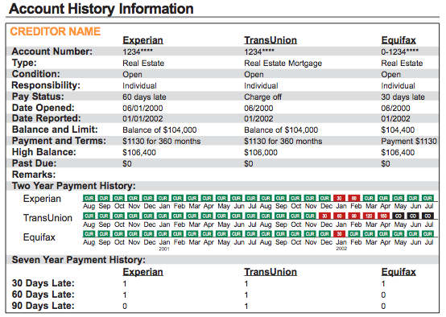
How Do You Read Your Credit Report?
Your FICO credit score is a 3-digit number between 300-850 determined from your credit report, and is used to determine if you are good credit risk.
www.myfico.com and www.bankingsense.com/good-credit-score-guide-fico-ranges/
Read it closely: look for errors, accounts/loans that you did not open, wrong addresses or employers.
These can be signs that you are a victim of identity theft.

Slide 29
How Do You Repair Your Credit?
If you are a victim of identity theft, file a police report. The police are required to take a report under California Penal Code § 530.6(a).
Dispute all errors with the credit reporting agencies.
This forces them to investigate the dispute(s).
Send a copy of the dispute and/or police report to the creditor at the address listed on the credit report.

Slide 30
How Do You Rebuild Your Credit?
Consider bankruptcy for debts that can be discharged.
Debts arising from fraud, or for which discharge would be against public policy (i.e. government, spousal or child support) are often nondischargeable.
Try to negotiate with creditors directly.
Be careful of companies offering to settle your debts for significantly less than owed.
Start with a secured credit card (refundable deposit required) or a gas card to establish a good credit history
Examples: Capital One Secured MasterCard (low deposit), Digital Federal Credit Union Visa Platinum Secured Credit Card (no annual fee), OpenSky Secured Visa Credit Card (does not require a checking account or good credit)

Slide 31
Rebuilding Your Credit (continued)
Pay in full; pay on time.
Decrease your credit utilization.
Check your credit report and credit score.
Protect existing credit.
Dispute incorrect information on your credit report.
Don’t open too many new accounts quickly.
The National Foundation for Credit Counseling offers free or low-cost help for rebuilding finances:
https://www.nfcc.org/
Notes:
How can you rebuild your credit?
It doesn’t cost anything to dispute mistakes or outdated items on your credit report. Both the credit reporting company and the information provider (the person, company, or organization that provides information about you to a credit reporting company) are responsible for correcting inaccurate or incomplete information in your report.
Write a letter to the nationwide credit reporting companies — Equifax, Experian, and TransUnion — attaching copies of all of the documents and tell them why the information on the report is wrong.
Ask that the error be corrected and send your letter by certified mail “return receipt requested.” Within 30 days credit reporting companies must investigate the items you question. They forward this information to the debt collector who is legally obligated to investigate it under The Credit Repair Organizations Act. Keep copies of what you send them. Keep notes of any phone calls.
When the investigation is complete, the credit reporting company also must give you the results in writing, along with a free copy of your report if the dispute results in a change.

Slide 32
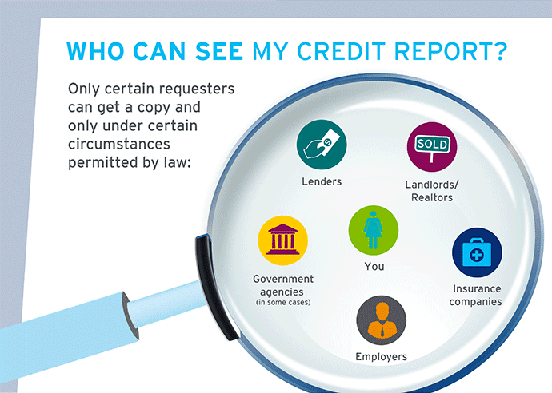
Credit Reports and Employment
The Employment Credit Check Law (2012) prohibits employers from requesting credit reports for Californians unless they are working or seeking work in a financial institution, law enforcement, or the Justice Department.
If one of these exceptions applies, you must be provided with notice in advance explaining the legal reason your credit report is needed.

Slide 33
BUDGETING

Slide 34
What is a Budget?
A budget is a monetary “plan” for a defined period of time (i.e. weekly, monthly, yearly) that’s helps you manage your money.
Calculate your “income.”
Calculate your “expenses.”
3. Subtract your expenses from income, the number should be positive.
34
Notes:
Discuss:
Most people have no idea where their money goes.
Those that do stay out of trouble and end up with more money over their lives.

Slide 35
Sample Budget
Income |  | Expenses
What they said you make | $3,000 | Rent | $750
Less taxes | - 1,300 | Utilities: Gas, water, Internet, phone | 100
What you bring home | $1,700 | Food | 250
 |  | Clothing | 25
 |  | Laundry | 20
 |  | Transportation | 300
 |  | Recreation | 30
 |  | Insurance | 90
 |  | Misc. expenses | 75
 |  | Total expenses | $1,640
Savings: $60
Notes:
Discuss:
Tell high school students who have never been employed how what they bring home will be less than what they thought they were making.
Mention the miscellaneous categories to accommodate Murphy’s Law.
Note recreation is important – otherwise it is like dieters who try to eat only celery for the rest of their lives.
Note that if the savings is negative, the person needs to get a roommate, move back home or get a better job.

Slide 36
Budgeting
Consider online budgeting tools, available as free smartphones apps
Mint: www.mint.com
Level Money: www.levelmoney.com
Personal Capital: www.personalcapital.com
Keep educating yourself: there are resources available online that can increase your financial awareness and assist in planning.
Money Steps Program for Former Justice Involved Individuals: http://moneystepsproject.org/
Notes:
These tools can also help you balance your checkbook and have helpful financial advice too.

